Slide 1
Data Solutions on Azure
Abdul Rasheed Feroz Khan
Microsoft MVP – Azure

Slide 2
Agenda
Overview of Azure.
Blob Storage.
Cosmos DB.
SQL Database.
SQL Data Warehouse.
File Sync.

Slide 3
Agenda – Day 1
Time | Topic
09:00 AM – 10:00 AM | Introduction
10:00 AM – 10:30 AM | Azure Blob Storage
10:30 AM – 11:00 AM | Tea Break
11:00 AM – 12:00 PM | Azure CosmosDB
12:00 PM – 01:00 PM | Azure SQL Database
01:00 PM – 02:00 PM | Lunch Break
02:00 PM – 03:00 PM | Azure SQL Data Warehouse
03:00 PM – 03:30 PM | Azure StorSimple
03:30 PM – 04:00 PM | Tea Break
04:00 PM – 05:00 PM | Azure File Sync

Slide 4
Agenda – Day 2
Time | Topic
09:00 AM – 10:00 AM | HDInsights
10:00 AM – 10:30 AM | Event Hubs
10:30 AM – 11:00 AM | Tea Break
11:00 AM – 12:00 PM | Stream Analytics
12:00 PM – 01:00 PM | Azure Data Lake Store
01:00 PM – 02:00 PM | Lunch Break
02:00 PM – 03:00 PM | Azure Data Bricks
03:00 PM – 03:30 PM | Azure Data Factory
03:30 PM – 04:00 PM | Tea Break
04:00 PM – 05:00 PM | Azure ML Studio

Slide 5

About the Instructor
Microsoft Most Valuable Professional – Azure
C# Corner Most Valuable Professional
Microsoft Certified Trainer
8 Years of experience as Cloud Consultant
Azure – AWS – GCP – IoT – Machine Learning – Cognitive Services – Bot – Xamarin – Big Data
Consultant for Accenture, Adobe, Boeing, Deloitte., Infosys, Johnson Controls, Microsoft, Wipro, etc.,
Abdul Rasheed Feroz Khan

Slide 6

About the Instructor
Microsoft Reconnect MVP
C# Corner Most Valuable Professional
Microsoft Certified Trainer
6 Years of experience as Cloud Consultant & Trainer
Azure – Machine Learning – Cognitive Services – Bot – Xamarin – Big Data
Consultant for Accenture, Adobe, Boeing, Deloitte, Johnson Controls, Microsoft, Wipro, etc.,
Mohammed Ramees

Slide 7
Azure global infrastructure
50 Azure regions
Available in 140 countries
Up to 1.6 Pbps of bandwidth in a region
Scale globally
Reach more locations, faster, with the performance and reliability of a vast global infrastructure.
Safeguard data
Rely on industry-leading data security in the region and across our network.
Promote sustainability
Help build a clean-energy future and accelerate progress toward your sustainability goals.
Notes:
Azure Functions is actually built on top of the WebJobs SDK

Slide 8
Azure Datacenter
Opened first datacenter in 1989
Investment of more than $15 billion on infrastructure
Geo-replication over 500 miles apart
24x7 monitoring by US screened persons

Slide 9
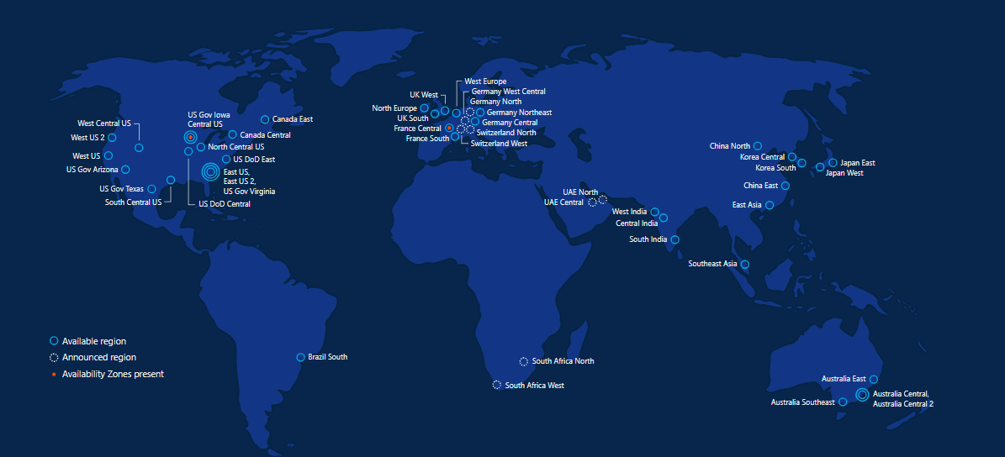
Azure regions – 50 Regions 140 Countries

Slide 10
Azure keep your data secure
Azure safeguards data in facilities that are protected by industry-leading physical security systems and are compliant with a comprehensive portfolio of standards and regulations.

Slide 11
Azure Developer Tools
Build apps that span IaaS and PaaS
Speed development of enterprise, web, mobile and IoT apps
Access the cloud directly from Visual Studio and other standalone and command-line tools
Build cloud apps for Java, Node, Python, Ruby, PHP, or .NET
Run Azure commands from your command-line interface
Diagnose live apps with world-class debuggers, profilers, diagnostic tools, and explorers

Slide 12
Azure Developer Tools
Visual Studio Tools for Azure
Azure SDK
Command Line tools
Azure PowerShell
Azure Command-Line Interface (Azure CLI)
PowerShell Tools for Visual Studio 2015
Storage Explorer
Visual Studio Code
Docker Tools
Azure Service Fabric Tools

Slide 13
Data Solutions on Azure

Slide 14
Azure Blob Storage
BLOB Storage – Binary Large Objects; any type of file or binary data; Storage for storing unstructured data. E.g., Documents, images, videos, logs files, VM Disks (vhd)
BLOB: https://accountname.blob.core.windows.net
Each BLOB can be of 100GB in size
Notes:
Selecting the right distribution method is key for good performance

Slide 15
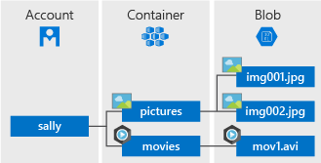
Azure Blob Storage
Notes:
Selecting the right distribution method is key for good performance

Slide 16
Storage Account
A unique namespace to store and access your Azure Storage data objects.
All objects in a storage account are billed together as a group.
By default, the data in your account is available only to you, the account owner.

Slide 17
Container
A container organizes a set of blobs, similar to a folder in a file system. All blobs reside within a container.
A storage account can contain an unlimited number of containers, and a container can store an unlimited number of blobs.
The container name must be lowercase.
BLOB name: MyNotes.txt
https://accountname.blob.core.windows.net/myContainer/MyNotes.txt

Slide 18
Blob
Azure Storage offers three types of blobs -- block blobs, append blobs, and page blobs (used for VHD files).
Page blobs
Used to store virtual hard disks optimized for random read/write operations
Block blobs
Used to store files like images and videos which are comprised of multiple blocks of data
Append blobs
Typically used with text files or log files where you append a line item to the end of a file.

Slide 19
Tiers
Hot storage tier
optimized for storing data that is accessed frequently
Cool storage tier
optimized for storing data that is infrequently accessed and stored for at least 30 days.
Archive storage tier
optimized for storing data that is rarely accessed and stored for at least 180 days

Slide 20
Why choose Azure Blob Storage?
Strong consistency
When an object is changed, it is verified everywhere for superior data integrity, ensuring you always have access to the latest version.
Object mutability
Get the flexibility to perform edits in place, which can improve your application performance and reduce bandwidth consumption.
Multiple blob types
Block, page and append blobs give you maximum flexibility to optimise your storage to your needs.
Easy-to-use geo-redundancy
Automatically configure geo-replication options in a single menu, to easily empower enhanced global and local access and business continuity.

Slide 21
Use cases
Serving images or documents directly to a browser.
Storing files for distributed access.
Streaming video and audio.
Writing to log files.
Storing data for backup and restore, disaster recovery, and archiving.
Storing data for analysis by an on-premises or Azure-hosted service.

Slide 22
Pricing
Total cost of Block Blob storage depends on:
Volume of data stored per month.
Quantity and types of operations performed, along with any data transfer costs.
Data redundancy option selected.

Slide 23
CosmosDB

Slide 24
Azure Cosmos DB was built from the ground up with global distribution and horizontal scale at its core – it offers turn-key global distribution across any number of Azure regions by transparently scaling and replicating your data wherever your users are.

Slide 25
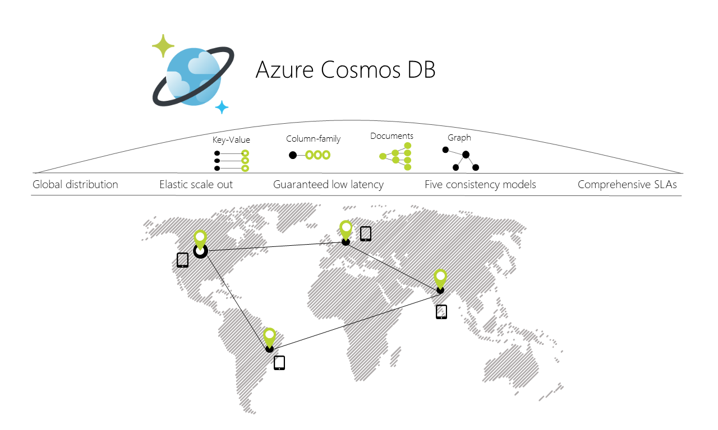
Azure Blob Storage
Notes:
Selecting the right distribution method is key for good performance

Slide 26
Why NoSQL Database?
Distributed
Replicas ensure high throughput/availability, and low latency
Scale-out
Horizontal partitioning enables virtually limitless storage and throughput
Schema-free
Document, table, graph, and columnar data models

Slide 27
Cosmos DB
Turnkey global distribution
Horizontal partitioning
Low latency (single-digit millisecond)
SLAs for guarantees on 99.99% availability, throughput, latency, and consistency
Local emulator
Multi-model, multi-API database
JSON (SQL API)
BSON (MongoDB API)
Graph (Gremlin API)
Key-value (Table API)
Columnar (Cassandra API)

Slide 28
Introducing the Local Emulator
Emulate Cosmos DB in a local development environment
Supports identical functionality as Azure Cosmos DB in the cloud
No need for:
Azure subscription
Cosmos DB account
Internet connection
Develop and test locally
Incur no costs
Deploy to the cloud when ready
http://aka.ms/cosmosdb-emulator

Slide 29
Multiple APIs and Data Models
Document
SQL API (JSON)
MongoDB API (BSON)
Key-Value
Table API
Graph
Gremlin AP
Columnar
Cassandra API

Slide 30
Measuring Performance
Latency
How fast is the response for a given request?
Throughput
How many requests can be served within a specific period of time?

Slide 31
Request Units
Request Units are Deterministic
The same request will always require the same number of request units
All Requests are Not Equal
Every Cosmos DB response header shows the RU charge for the request
Throughput Currency
Blended measure of computational cost (CPU, memory, disk I/O, network I/O)

Slide 32
Reserving Request Units
Provision request units per second (RU/s)
How many request units (not requests) per second are available to your application
Exceeding reserved throughput limits
Requests are “throttled”

Slide 33
Application checklist
What does a typical item look like?
What are the typical queries that users will run?
How many writes per second are required?
How many queries per second are required?
What is the acceptable consistency level?
What is the indexing policy?
Request Unit Calculator https://www.documentdb.com/capacityplanner

Slide 34
Pricing
SSD Storage
$0.25 per Month
Throughput
$0.08 per 100 RU/s per hour
$0.32 per 400 RU/s per hour
$23.424 per 400 RU/s per hour

Slide 35
Replication – Why?
Performance
Within a region, ensures SLA on RUs purchased
Across regions, brings data closer to the consumer
Business continuity
In the event of major failure or natural disaster

Slide 36
Turnkey Global Distribution
Associate any number of regions with your Cosmos DB account
Limited to geo-fencing policies
Dynamically add/remove regions
Associate (and disassociate) regions with the click of a mouse
Failover priorities
Choose preferred region, followed by regions for failover in order of preference

Slide 37
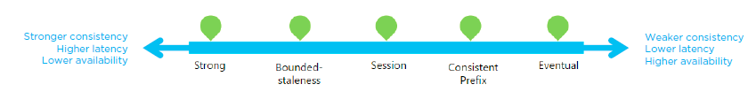
Replication and Consistency
How do you ensure consistent reads across replicas?
Define a consistency level
Replication within a region
Data moves extremely fast (typically, within 1ms) between neighbouring racks
Global replication
It takes hundreds of milliseconds to move data across continents

Slide 38
Five Consistency Levels
Strong
No dirty reads
Bounded staleness
Dirty reads possible
Bounded by time and updates
Session
No dirty reads for writers (read your own writes)
Dirty reads possible for other users
Consistent prefix
Dirty reads possible
Reads never see out-of-order writes
Eventual
Stale reads possible
No guaranteed order

Slide 39
Capability comparison
Capabilities | Relational databases | Non-relational (NoSQL) databases | Azure Cosmos DB
Global distribution | No | No | Yes, turnkey distribution in 30+ regions, with multi-homing APIs
Horizontal scale | No | Yes | Yes, you can independently scale storage and throughput
Latency guarantees | No | Yes | Yes, 99% of reads in <10 ms and writes in <15 ms
High availability | No | Yes | Yes, Azure Cosmos DB is always on, has well-defined PACELC tradeoffs, and offers automatic and manual failover options
Data model + API | Relational + SQL | Multi-model + OSS API | Multi-model + SQL + OSS API (more coming soon)
SLAs | Yes | No | Yes, comprehensive SLAs for latency, throughput, consistency, availability

Slide 40
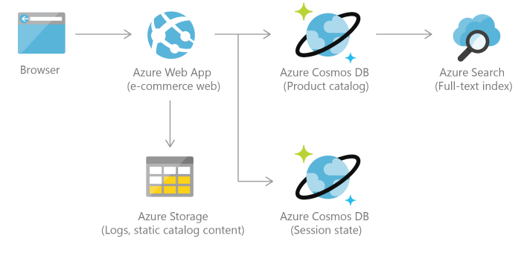
Use cases - Retail and marketing

Slide 41
SQL DB

Slide 42
Components of Azure SQL database
SQL Server.
SQL Database.
Server level Firewall.
Database level Firewall.
Tables.

Slide 43
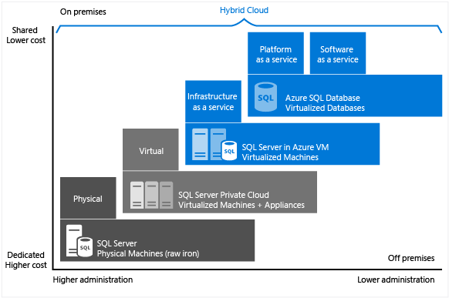
SQL Server IAAS & PAAS

Slide 44
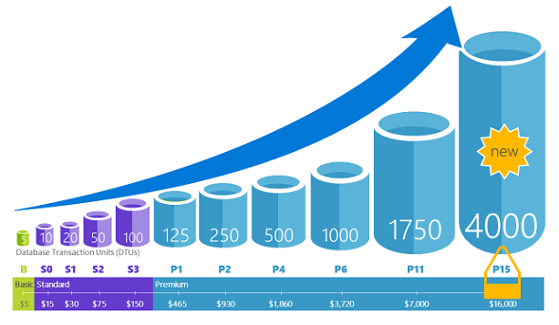
Performance and scaling

Slide 45
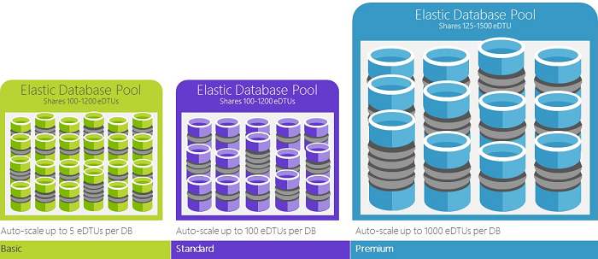
Elastic pool

Slide 46
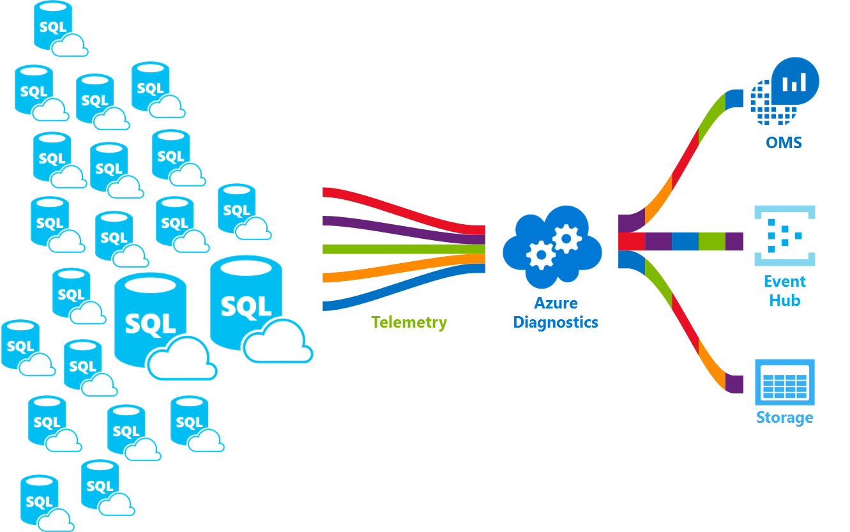
Monitoring

Slide 47
Azure SQL Data Warehouse

Slide 48
A cloud-based Enterprise Data Warehouse that leverages Massively Parallel Processing to quickly run complex queries across petabytes of data

Slide 49
Azure SQL Data Warehouse
A Platform as a Service in Microsoft Azure cloud
It’s a Massively Parallel Processing system (MPP)
Distributed Compute and Distributed Storage
Scale up and down in couple of minutes
Pause compute resources

Slide 50
Scale Up vs. Scale Out (SMP vs. MPP)
SMP - Symmetric Multiprocessing
Multiple CPUs used to complete individual processes simultaneously
All CPUs share the same memory, disks, and network controllers (scale-up)
All SQL Server implementations up until now have been SMP
MPP - Massively Parallel Processing
Uses many separate CPUs running in parallel to execute a single program
Shared Nothing: Each CPU has its own memory and disk (scale-out)
Segments communicate using high-speed network between nodes

Slide 51
Why Cloud over On-Premises?
Doesn’t need large capital expenses to get started
Doesn’t need staff to maintain hardware, virtualisation or the Operating System
Can scale storage and compute up and down on demand

Slide 52
MPP Benefits with the SQL Data Warehouse
Size compute power independent of storage needs
Grow and shrink compute without moving data
Cost savings
Pause compute capacity while leaving data intact, only paying for storage
Resume compute capacity during office hours

Slide 53
Why Azure SQL Data Warehouse ?
Scale and performance
Make data go further. SQL Data Warehouse gives you a cloud solution which removes limits to scale and performance.
Elastic and extensible
Optimise data warehouse performance and lower costs by scaling compute and storage independently.
Trusted and secure
Count on enhanced security features and industry-leading compliance. SQL Data Warehouse is compliant across more than 50 certifications and available across global regions.
Seamless integration
Combine with leading data integration and BI solutions. SQL Data Warehouse is compatible across Microsoft and leading data integration and visualisation vendors such as Tableau and Informatica.

Slide 54
Service Capabilities
Limitless concurrency
Unleash the power of data with 128 concurrent queries and scale to unlimited queries with Azure Analysis Services integration.
Process any kind of data
Coupled with Azure Databricks and Azure HDInsight, easily connect and integrate your curated data into your data warehouse with PolyBase
Lightning-fast provisioning
Provision thousands of compute cores in under five minutes and scale to petabyte in hours.
Truly elastic by design
Independently and elastically scale compute and storage to adjust to your unique business needs.

Slide 55
Service Capabilities
Advanced security
Built-in features include Virtual Network service endpoints, advanced threat detection, always-on encryption, audit and simplified secure access through Azure Active Directory.
Fully managed infrastructure
Automatically provision infrastructure, optimisation and more, so that you can focus on driving value from your data.
Industry leading SQL engine
SQL Data Warehouse is built on SQL Server, the industry’s top performing SQL engine, with the most comprehensive support for SQL language.
Global availability
The most geographically available data warehouse service in the cloud, available in more than 33 regions. Keep your data where your users are.

Slide 56
Data Warehousing Unit (DWU)
A measure of the underlying computing power of Database
In Data Warehousing you need not to configure CPUs, RAM and Storage, instead we use DWUs
100 DWU
Loaded 3 tables in 15 minutes
Ran a report in 20 minutes
500 DWU
Loaded the same three tables in 3 minutes
Ran the same report in 4 minutes

Slide 57
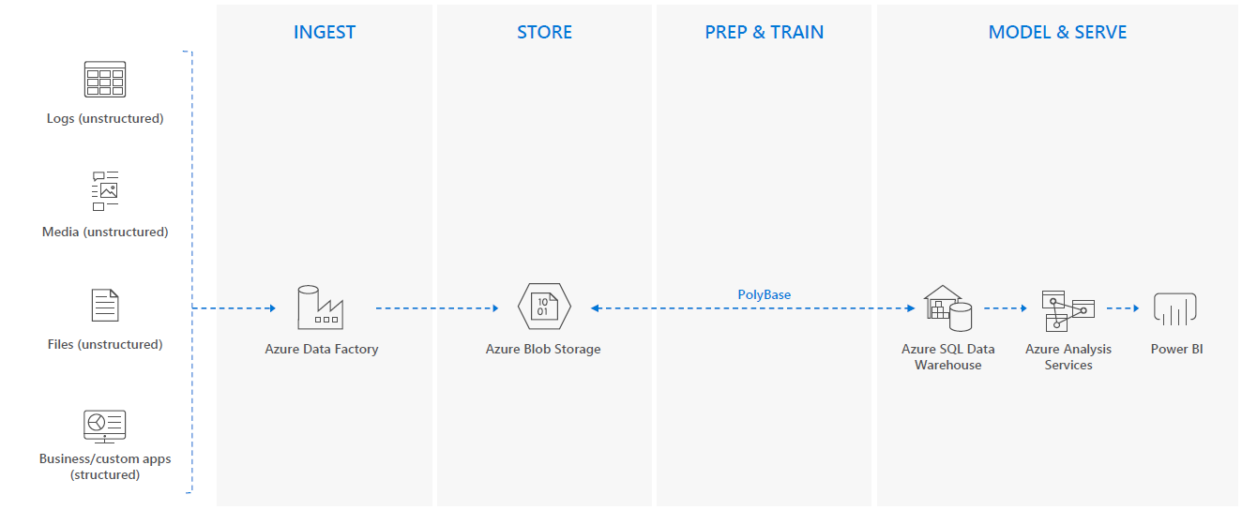
The workflow

Slide 58
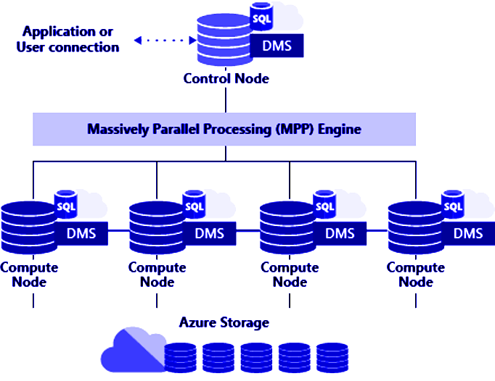
Architecture Azure SQL DW
Applications connect and issue T-SQL commands to a Control node
The Control node runs the MPP engine which optimizes queries for parallel processing
Then passes operations to Compute nodes to do their work in parallel
Compute nodes store all user data in Azure Storage and run the parallel queries.
Data Movement Service (DMS) is a system-level internal service that moves data across the nodes as necessary to run queries in parallel and return accurate results

Slide 59
Architecture Azure SQL DW
Data Warehouse Units | # of Compute nodes | # of distributions per node
100 | 1 | 60
200 | 2 | 30
300 | 3 | 20
400 | 4 | 15
500 | 5 | 12
600 | 6 | 10
Data Warehouse Units | # of Compute nodes | # of distributions per node
1000 | 10 | 6
1200 | 12 | 5
1500 | 15 | 4
2000 | 20 | 3
3000 | 30 | 2
6000 | 60 | 1

Slide 60
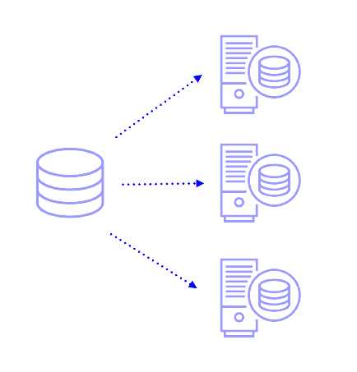
Distribution Key
Distribution Key - Determine the method in which Azure SQL Data Warehouse spreads across multiple nodes
Distribution – SQL Database which stores one or more distributed table
Splits data table to 60 buckets through compute nodes
Hash distributed table
Round-Robin distributed table
Notes:
Selecting the right distribution method is key for good performance

Slide 61
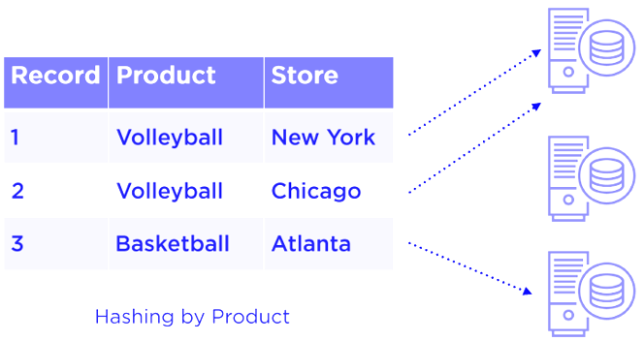
Hash distributed
Data divided across nodes based on hashing algorithm
Same value will always hash to same distribution
Optimal for large fact tables
Data Skew can be an issue when distributing on high frequency values

Slide 62

Avoid Data Skew

Slide 63
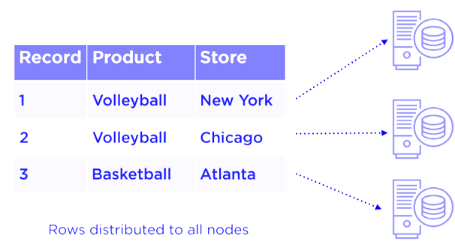
Round-Robin distributed
Data distributed evenly across nodes
Easy place to start, don’t need to know anything about the data
Useful for dimension tables and tables without a good hash column
Will incur more data movement at query time

Slide 64
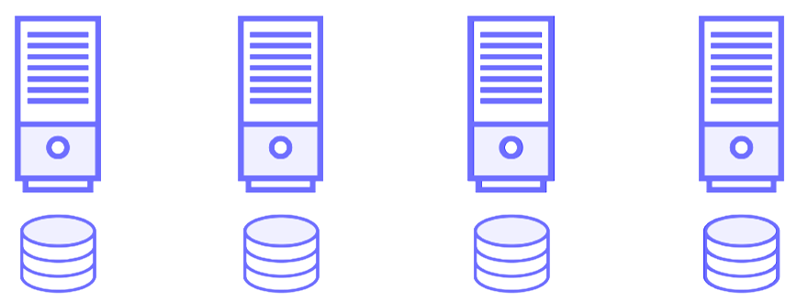
Even Distributions

Slide 65
Designing for Azure SQL Data Warehouse
SQL Server ≠ Azure SQL Data Warehouse
Require design decision that are different from SQL Server

Slide 66
Good Hash Key
Distributes Evenly
Take full advantage of the compute power
Used for grouping
Mostly accessed records in the same distribution
Used as Join condition
Is not updated
Has more than 60 distinct values
Round Robin will always provide a uniform distribution but not necessarily the best performance

Slide 67
Data Types
Use the smallest data type which will support your data
Avoid defining all the character columns to the largest default length
Define columns as VARCHAR rather than NVARCHAR if you don’t need Unicode
The goal is not only to save the space but also move data efficiently as possible

Slide 68

Migration Utility
Supports SQL Server 2012+ and Azure SQL Database
Provides a Migration report pointing out possible issues
Assist the schema migration
Assist with Data Migration
https://www.microsoft.com/en-us/download/details.aspx?id=49100

Slide 69
Methods of Provisioning
Portal
New – Databases
PowerShell
New-AzureRmSqlDataBase cmdlet
T-SQL
CREATE DATABASE command

Slide 70
Provisioning the Data Warehouse
Select the region
Recommended to select the same region, if your have already services in Azure that provide data for the Data Warehouse
In case of on premises, select a region closest to it
Select or create a server
Pick the origin of the data
Pick your DWU level

Slide 71
Pricing
Storage
Storage is billed by Gigabyte
Standard or Premium Geo Redundant
No cost for storage transactions
Outbound data transfer is billed
Compute
Compute is billed by DWUs in Gen1 ND cDWUs in Gen2
Can go from 100 to 6000 in Gen1 and 1000 to 30000 in Gen2
Billed per hour
When not in use computer power of Data Warehouse can be completely paused for maximum savings
Notes:
Loading a lot of data inside DW is not billed, Taking out data outside azure data center will be charged
Gen2 uses a local disk-based cache on the compute nodes to improve performance. When you scale or pause the system, the cache is invalidated and so a period of cache warming is required before optimal performance is achieved.

Slide 72
Keeping up to Date
In the cloud service details can change
Refer to azure.com for the latest information

Slide 73





Customers

Slide 74
File Sync

Slide 75
Service Capabilities
Centralize file service in Azure Storage
Cache frequently accessed files for fast, local access
Utilize cloud-based backup and fast disaster recovery
Preserving on-prem compatibility and performance

Slide 76



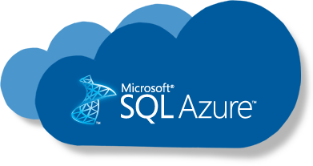


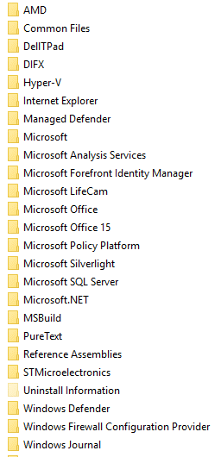

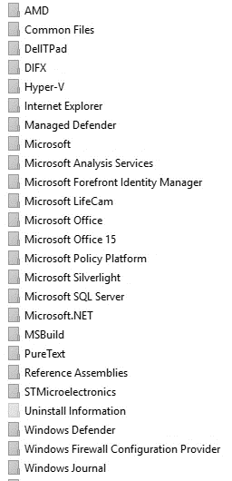





PaaS
IaaS
SMB
REST
West Europe
East US
Azure Backup Vault
File Share
File Share
Work Folders
SMB
NFS
Users
Applications
!
Branch Office
HQ Server
Branch Office

Slide 77
Service Capabilities
Multi-site sync
Keep a data set in sync across multiple locations
Cloud tiering
Turn a server into a lightweight, performance cache for Azure Files
Direct cloud access
Native file format with SMB or REST access
Integrated cloud backup
Point-in-time recovery and retention policies without redundant data transfer
Rapid file server DR
Fast namespace sync with no need to wait for data restore

Slide 78

Customer Stories – TSK
International consultancy / design firm with deep expertise in design, fit-out, and refurbishment of corporate workplaces worldwide
Customers include Cap Gemini, Kellog’s, and TicketMaster
UK datacenter, geographically dispersed locations
Fast, creative response requires distributed collaboration amongst talent pools, re-use of prior art
Desire: leverage cloud to keep IT effort low, business productivity high

Slide 79
Challenges
Managing storage in multiple locations, including data management and backup
Unable to collaborate effectively due to the nature of local storage / replication
Desire to leverage the Azure Cloud to allow TSK to devote resources to business drivers versus ‘housekeeping’
Backup cost/efforts – Availability management – Capacity management – Audit/compliance – server sprawl
‘Known’ approaches couldn’t provide the required results
Replication / Synchronization / Content Distribution

Slide 80
Solution
Work with MSFT GOLD cloud competency specialist (Building Zones) to address the issue from a cloud-first paradigm
Centralize/consolidate data into Azure Files ensuring global access, availability
Leverage Talon FAST™ for
single view of data by all users through Global Namespace
Local-like performance profile via intelligent caching, file level differencing
Even with data-hungry client apps such as design, graphics, etc.
True collaborative workflow via global file locking technology
Seamless user experience with no change in applications/workload/IT infrastructure
Fast, streamlined provisioning via Azure Marketplace
RESULT: Streamlined business operations, global collaboration, lower costs, cloud benefits realized

Slide 81









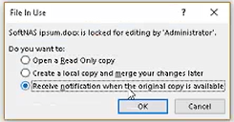
TSK Global Consolidation Methodology
Centralized “Single Set of Data” in Azure Files
FAST™ Fabric
Location A
Location B
Location C
Data consolidated into a central Azure Files share for all to use
Talon FASTTM software is installed at core and each edge joining the Fabric
User navigates to share as normal and requests an ‘open’, and is authenticated
FAST core facilitates session, and locks the file centrally for any collaborative data
If the data hasn’t been used in that location prior, the file is streamed using optimized protocols
Otherwise, files are served locally out of cache, with any changes differenced to the authoritative copy
If a user at another location attempts to edit, he’s informed that file is in use, and presented his options…
Upon close/exit, changes are saved, the lock is released, and the other user can immediately engage on the single version of truth

Slide 82
File Share - Requirements
Storage Account
Azure File Share
Windows Server Machine
File Sync Client.

Slide 83
Thank you

